Slide 1
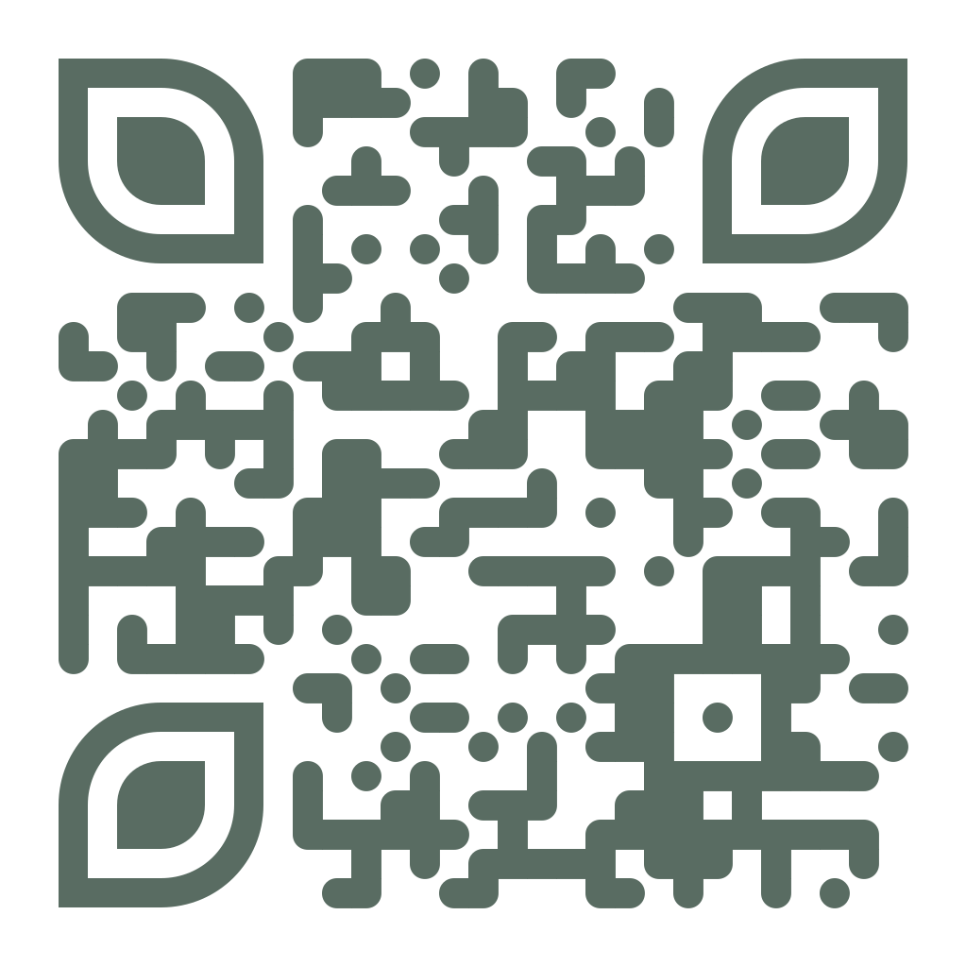
Notes:
Will County’s Executive Office has launched Illinois’s first-ever Alternative Fuels Readiness Plan.
This plain will evaluate the future infrastructure needs for Electric Vehicles and other Alternative Fuel Vehicles, such as hydrogen, biodiesel, ethanol, and natural gas.
This is just one of many initiatives Will County is undertaking to support our community in providing more sustainable transportation options for residents, visitors, and businesses.

Slide 2
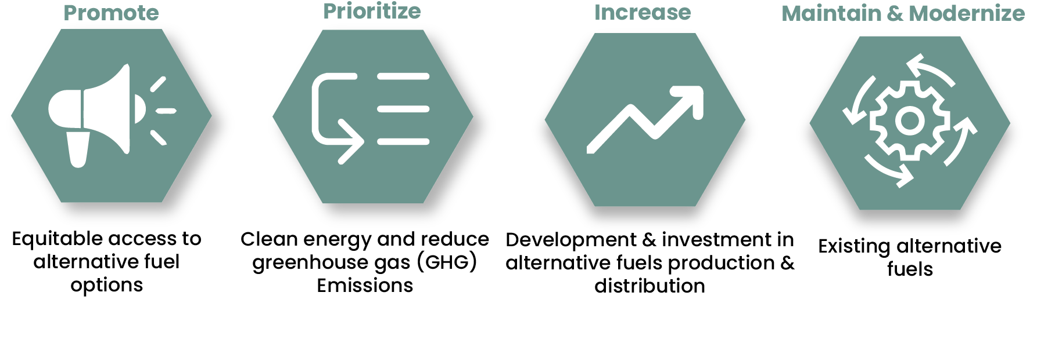
Alternative Fuels Readiness Plan Overview
The Will County Alternative Fuels Readiness Plan (AFRP) aims to prepare the county for the increasing demand for alternative fuel vehicles.
Community involvement is encouraged through public meetings, focus groups, surveys, and tabling events.
Notes:
The Plan will prepare our community for an increasing demand for alternative fuels, the County develop strategies to meet the practical, immediate needs and make meaningful progress to support the County’s initiatives to promote more clean energy.
The goals of the plan are to: promote equitable access to alternative fuels, prioritize clean energy and reduce greenhouse gas emissions, increase the development and investment in alternative fuel production and distribution, and maintain and modernize existing alternative fuels.
The success of this plan will depend on community involvement in providing feedback throughout the development of the plan.

Slide 3
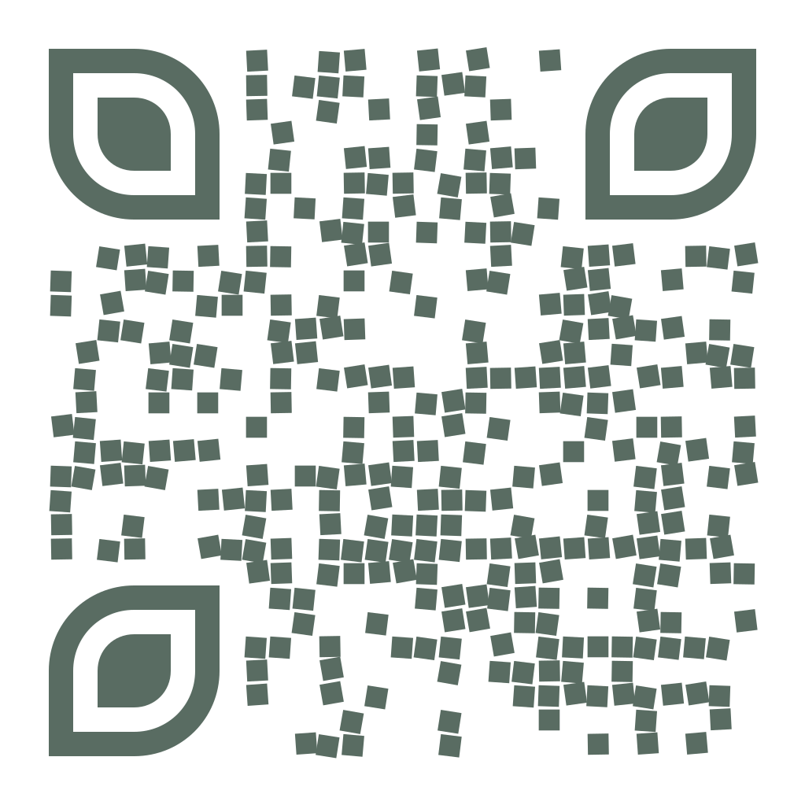
Get Involved!
Your input and feedback are greatly appreciated and necessary for the success of the project! Contact us at info@willcountyaltfuels.com.
Visit the Project Website: WillCountyAltFuels.com
Participate in the Interactive Map!
Notes:
An Interactive Mapping Survey is open to share your thoughts, suggestions, and concerns on the placement of Electric Vehicle and Alternative Fuel charging infrastructure. You can access the survey via the QR code on this slide. This survey is intended to support the team in providing additional input to support the planning of future infrastructure, pinpoint desired fueling locations, and contribute to a more sustainable environment for residents, visitors, and businesses.
For additional information on the project, educational resources, and for feedback opportunities throughout the project, please visit the project website at willcountyaltfuels.com.
Finally, feel free to reach out directly to the project team at info@willcountyaltfuels.com

